Slide 1
MOTECH
Mobile Technology for Community Health (MOTECH) is a modular, extensible open source software project originally designed for mobile health (mHealth), which can also be used outside of the health domain.
It allows organizations to use mobile technology to communicate information to patients, collect data about patients, alert caregivers to patients’ status, and schedule caregivers’ work.
The modular system allows organizations to choose among multiple mHealth technologies and to enable data sharing for users of the system.

Slide 2
MOTECH Architecture Overview
MOTECH consists of the core platform and several modules, each providing use of a technology such as SMS or email, or access to an external system such as CommCare.
Organizations can choose to install one or more modules, and developers can extend MOTECH by writing new modules.
MOTECH is written in Java. It depends on open source systems including Apache Tomcat, Apache ActiveMQ, and Quartz.

Slide 3
Core Architecture
MOTECH can logically be broken into the core platform and modules.
The core platform wraps several well-known open source systems, and augments and exposes their features to the other components.
The main functions of the core are to wrap ActiveMQ (which provides the message queue) and present an internal pub/sub like event interface to the module and implementation layers.
The core also provides a module loading environment (OSGi), an interface to the Scheduler, and access to the database.

Slide 4
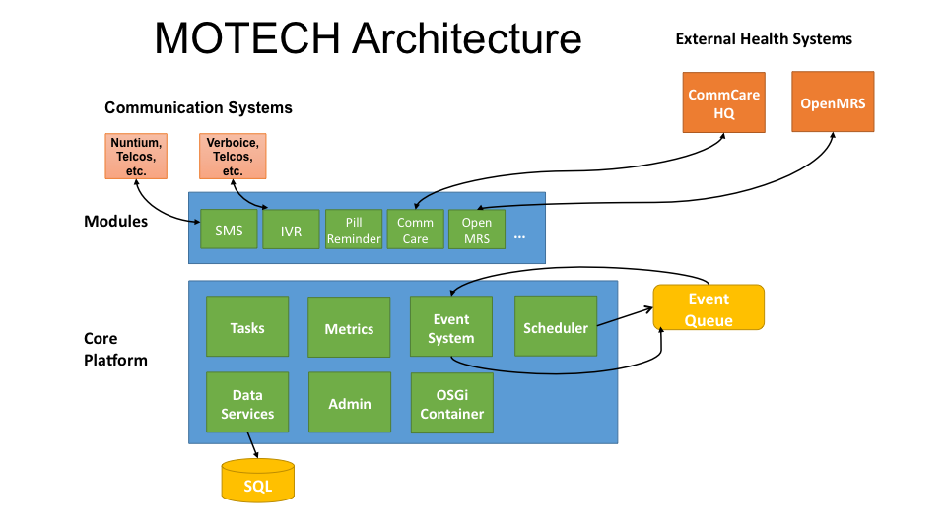

Slide 5
Modules Architecture
Modules within MOTECH are self-contained bundles of functionality that are loaded into the server via the OSGi host.
Modules interact with the core platform through its APIs and with other modules, either through their APIs or by consuming their events. Modules can expose service interfaces of their own as well as emit their own events.
Modules may also register servlet controllers, which allow them to respond to HTTP requests.

Slide 6
Modules
Alerts
Collects alerts for users in an inbox-like container
Appointments
Provides appointment scheduling and reminding
Call Flow
Manages the sequence of greetings and prompts for an Interactive Voice Response (IVR) call
CMS Lite
Provides basic content storage and retrieval
CommCare
Integrates the MOTECH platform with CommCareHQ, an open-source platform to help manage community health workers
Mobile Forms
Supports configurable forms and data collection through mobile devices that support the OpenXData format
MRS (Medical Record System)
Provides a basic specification for integrating the platform with a medical record system
OpenMRS
Integrates the MOTECH platform with OpenMRS, an open source electronic medical record platform
Outbox
A voicemail-like messaging system for end users
Pill Reminder
A flexible reminder system focused on medication
Schedule Tracking
Enrolls users for alerts based on complex scheduling rules

Slide 7
Data Services
Integrates data from external data sources and provides sharable data schemas
Decision Tree[Deprecated]
Provides APIs for constructing an IVR decision tree
Email
Sends and logs email messages
Event Aggregation
Groups common events and republishes them as a single event at a specified time
Event Logging
Allows MOTECH modules to easily see each others’ events
IVR
Integrates the MOTECH platform with Interactive Voice Response (IVR) services
IVR Asterisk
Connects the MOTECH platform IVR with an Asterisk server using the VoiceGlue VoiceXML browser
IVR Kookoo
Integrates the MOTECH platform with Kookoo’s hosted IVR service
IVR Verboice
Integrates the MOTECH platform with Verboice’s hosted IVR service
IVR Voxeo
Integrates the MOTECH platform with Voxeo’s hosted IVR service
Message Campaign
Enrolls users in message campaigns with flexible content-scheduling rules

Slide 8
Metrics
Displays web site metrics using logging and the open source tools StatsD and GraphiteScheduler
Publishes events on a schedule, using the open source Quartz engine.
SMS
Provides a basic specification for integrating the MOTECH platform with an SMS provider to send/receive SMS messages
Tasks
Responds to specified triggers; for example, a task can be set to enroll a patient in an alerts schedule in response to an incoming SMS message with a particular subject

Slide 9
What can MOTECH do?
The MOTECH Platform can be used for setting appointments, tracking any scheduled activity, and managing workers deployed in the field.
Its initial implementations have been for mHealth projects that improve health by sending messages to patients and caregivers based on an evaluation of the recommended schedule of care compared to the patient’s health-related actions.
Some features of typical MOTECH-based applications are:

Slide 10
Communicate information to patients via voice or SMS according to a schedule of care defined for the patient’s condition, e.g.:
Reminders for ANC appointments, lab visits, etc.
Reminders to take medication on schedule, e.g., DOTS, ART, etc.
Reminder notices to take children for scheduled immunization services

Slide 11
Collect data from patients or caregivers, e.g.:
Patients report their symptoms prior to treatment or during treatment (adverse events)
Patients give feedback on service delivery
Caregivers report what service was delivered to a patient and on what date

Slide 12
Alert caregivers of the status of their patients, e.g.:
Notify Community Health Worker when patient has not taken ART, DOTS or other drugs
Notify nurse when patient has not kept a scheduled appointment (e.g., ANC visit)

Slide 13
Facilitate communication between patients, caregivers, and/or health administrators, e.g.:
Establish secure peer networks for patients who share similar health concerns
Initiate conversations between patients and caregivers in a way that allows the caregiver to manage the workload effectively

Slide 14
Installing MOTECH
Installing on a Macintosh
Installing Prerequisites for MOTECH
Installing HomeBrew
To install Homebrew, run the following in the terminal
ruby -e "$(curl –fsSL https://raw.github.com/Homebrew/homebrew/go/install)"
Use Homebrew to install git, erlang, ActiveMQ, and Apache Tomcat:
brew install git
brew install activemq
brew install tomcat
brew install maven
Homebrew installations are locatedin /usr/local/Cellar` with symlinks in ``/usr/local/bin, which should already be part of your $PATH environment variable.
Note
Homebrew provides instructions about how to run these applications, as well as how to have launchd start them automatically on system startup.

Slide 15
Configuring Tomcat:
Edit the tomcat-users.xml file to add an admin user. Insert a line similar to the following before the closing </tomcat-users> tag:
<user username="motech" password="motech" roles="manager-gui"/>
Installing JDK 7:
Mac OS includes JDK6 by default, however JDK 7 is required for MOTECH. Use theseinstructions to install the latest version of the JDK.
Installing MySQL:
Before installing MySQL, you will need Xcode from the App Store. This can take a while; it’s a big download.
Next start Xcode from the Launchpad (rocketship icon in the dock) and select Install. Then you can quit Xcode; you don’t need to keep it running.
Note
(Command Line Tools using Xcode are included in OS X Mavericks, but not previous OS versions. If you are running Mountain Lion, you can follow these instructions: http://blog.mclaughlinsoftware.com/2012/12/10/mountain-lion-pre-mysql/)
Go to http://dev.mysql.com/downloads/mysql/ and download the appropriate DMG archive. Open it, double-click on the installer, and follow directions.
Once mysql has finished installing, double-click the MySQL preferences pane in the DMG and follow instructions. For more details see ‘these instructions’_ .
Note
Homebrew can be used to install MySQL, however Homebrew will not install the Mysql System Preferences control panel.

Slide 16
Setting up Symbolic Link and Environment Variables
Create a symbolic link from the Tomcat directory (Homebrew installs into/usr/local/Cellar/tomcat/<version number>/libexec) to /usr/local/tomcat:
ln -s /usr/local/Cellar/tomcat/`brew info tomcat | grep stable | awk '{print $3}' | sed 's/,//'`/libexec /usr/local/tomcat
Edit your ~/.bash_profile to set environment variables (catalina is Tomcat):
export JAVA_HOME="/Library/Java/Home"
export MAVEN_OPTS="-Xmx512m -XX:MaxPermSize=128m"
export CATALINA_HOME="/usr/local/tomcat"
export CATALINA_OPTS="-Xms1024m -Xmx2048m -XX:MaxPermSize=1024m"
export PATH=/usr/local/mysql/bin:$PATH
When you’re done editing:
source ~/.bash_profile
Jump to the Building and Installing MOTECH section to install MOTECH

Slide 17
Building and Installing MOTECH
Getting the MOTECH code
List of MOTECH repositories
Generic developer git workflow
Building MOTECH
Assuming you issued the git clone command in your home directory root, in the terminal
$ cd ~/motech
$ mvn install
b.) It takes some time to build MOTECH, but eventually you should see:
[INFO] ------------------------------------------------------------------------
[INFO] BUILD SUCCESS
[INFO] ------------------------------------------------------------------------
[INFO] Total time: 29:19.284s
[INFO] Finished at: Fri Jun 07 12:12:43 PDT 2013
[INFO] Final Memory: 152M/378M
[INFO] ------------------------------------------------------------------------
Note
Should you get a java.lang.OutOfMemoryError exception, it may be because you forgot to set MAVEN_OPT as described in [3.5]. But you may need to increase -Xmx. So something like -Xmx1024m might work.
Install MOTECH
In a browser, go to http://localhost:8080

Slide 18
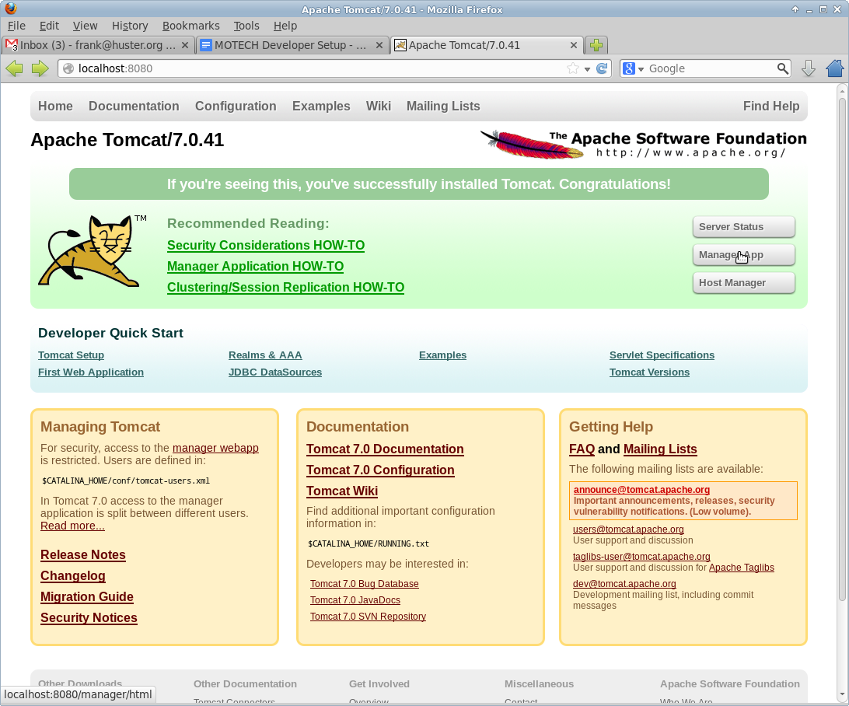

Slide 19
Click on Manager App
Type the user/password you used in tomcat-users.xml
temporary hack you need to remove ~/.motech/config/motech-settings.conf to allow the create initial user wizard.
In the Tomcat Web Application Manager, scroll down to the Deploy section and the WAR file to deploy subsection, click on Browseand select or navigate to~/motech/platform/server/target/motech-platform-server.war then click on Deploy

Slide 20
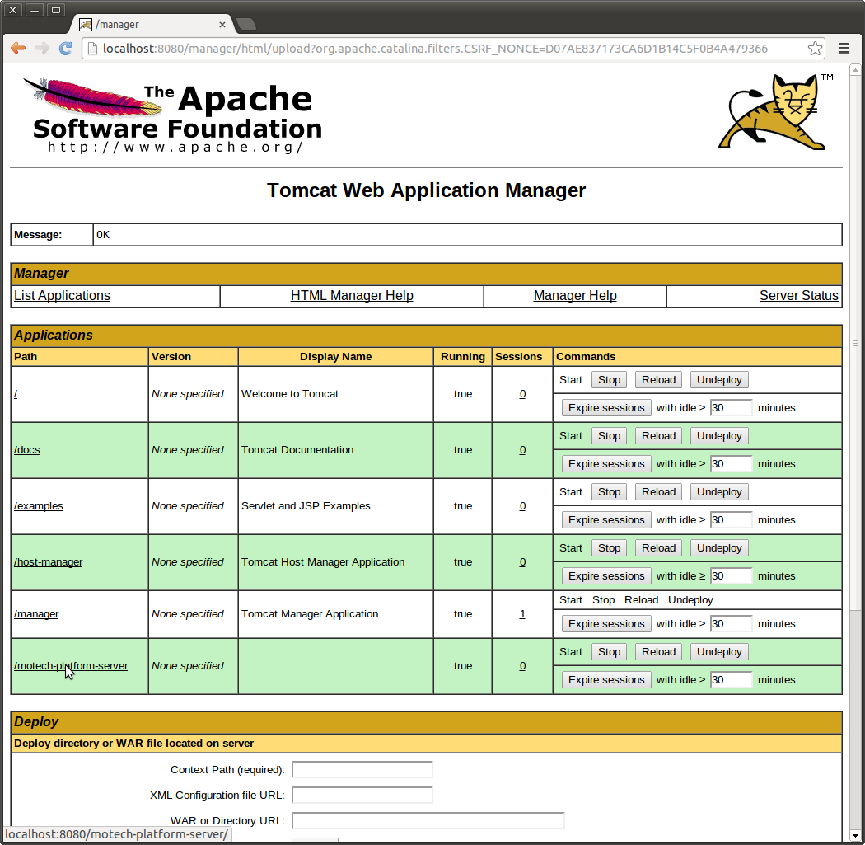

Slide 21
Depending on your machine it could take a while for motech-platform-server to deploy
In the Tomcat Web Application Manager page, click on /motech-platform-server, you get the MOTECH initial user screen

Slide 22
